Slide 1
Advanced Pacting
Beth Skurrie / Yousaf Nabi
@bethesque / @you54f

Slide 2
Topics
Writing consumer tests
Verifying Pacts
Using branches and environments
CI/CD
Organisational Scale
Questions

Slide 3
Writing consumer tests
Notes:
This is obviously a huge topic, so I’m going to focus on a few things in particular.

Slide 4
Writing good consumer tests
The key is knowing what *not* to test.
Restraint!
It is easy to write Pact tests that are
Brittle
Overly strict
Burdensome

Slide 5
Writing good Pact tests
is the difference between a
useful Pact implementation
and one which makes everyone wish they’d stuck with integration tests.

Slide 6
What does a good Pact test look like?
There should be sufficient assertions to ensure that the response from the provider will not break the consumer while also keeping:
The scope of the consumer code under test as small as it can be.
The expectations on the response as loose as they can be.
The focus on the messages (request/response), not the implementation.

Slide 7
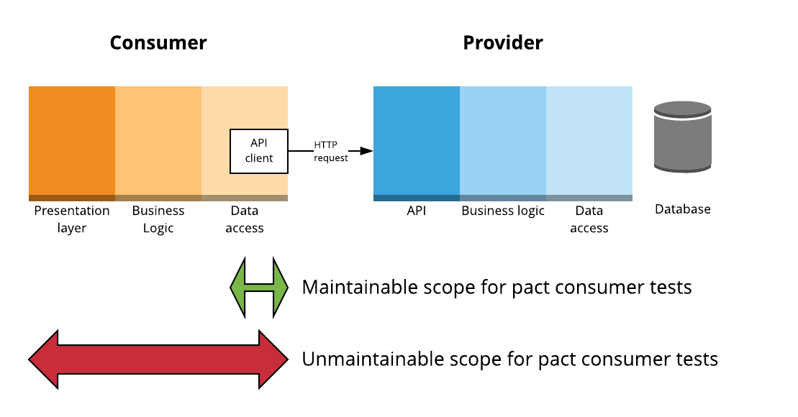
Scope, scope, scope

Slide 8
Why not include the UI/business logic layers?
Maintainability
Using Pact to test UI concerns causes interactions with minor variations to be added to the contact that don’t meaningfully increase test coverage, but do increase the maintenance of the provider verifications.

Slide 9
Provider API Client Responsibilities
Converts back and forth between the business domain classes and concepts of the consumer and the HTTP requests and responses required to communicate with the provider
Abstracts the HTTP-ishness of the provider
Eg. 200 returns an object, 404 returns null, 401 raises a validation error

Slide 10
Options for “top to bottom” consumer tests
Use the pact generated by the unit tests along with a pact stub server.
Use a separate HTTP mock library and use shared fixtures between both the pact tests and the “top to bottom” tests.
Use a separate HTTP mock library and parse the generated pact to initialise the mock.

Slide 11
Pact Matchers - the main ones (v2)
Type based matching
Regular expressions

Slide 12
Type based matching - objects
like(“foo”) - match any string
like(1) - match any number
like(true) - match any boolean
like({
“name”: “foo”,
“address”: {
“street”: “Flinders St”
}
})

Slide 13
Type based matching - arrays
eachLike(“foo”) - an array of strings
eachLike(1) - an array of numbers
eachLike(true) - an array of booleans
eachLike({
“name”: “foo”,
“address”: {
“street”: “Flinders St”
}
})

Slide 14
Type based matching - arrays
eachLike({
“name”: “foo”,
“address”: {
“street”: “Flinders St”
}
}, { “min”: “2} )

Slide 15
Things to remember
Responses can have extra keys without failing the verification, but requests cannot - Postel’s Law.
You can be as strict as you like on requests - they’re your own tests.
V3 matchers https://github.com/pact-foundation/pact-specification/tree/version-3
Pact doesn’t support optional fields - [] or [{foo: “bar”}]
Verifications may validate against only [] and pass, but fail in production

Slide 17
Functional vs contract tests
Contract tests focus only on the messages (request and response)
When I send
POST /widgets
Request body containing widget properties
I receive
200 OK
Location header with URL of new widget
Response body containing widget properties
Functional tests also check for side effects
All of the above checks
Plus: is the widget stored correctly in the repository?

Slide 18
POP QUIZ
Could you “hardcode” a provider implementation that passes the contract tests, but actually doesn’t persist any data?

Slide 19
POP QUIZ
Could you “hardcode” a provider implementation that passes the contract tests, but actually doesn’t persist any data?
YES!!!!
What stops us doing this?
The functional tests in the provider’s own codebase

Slide 20
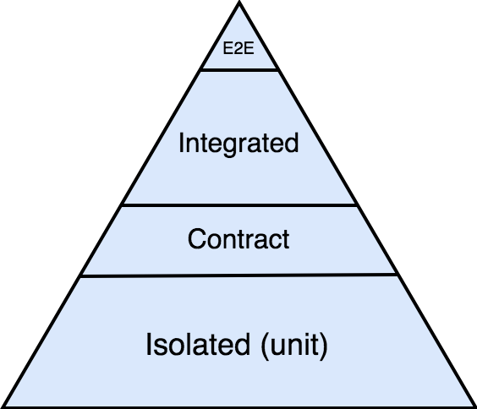
Contract tests aren’t designed to operate alone

Slide 21
It’s not the job of the consumer to be a test harness for the provider
It’s not the job of the consumer to be a test harness for the provider

Slide 22
Is there duplication between functional and contract tests?
Yes, but not entirely
A contract test only covers the attributes of the request and response that a particular consumer cares about
By design it excludes things that the consumer does not care about
Functional test covers all the functionality available to all the consumers

Slide 23
Bad example - functional test
When "creating a user with a username with 21 characters"
POST /users { "username": "thisisalooongusername" }
Then
Expected Response is 400 Bad Request
Expected Response body is { "error": "username cannot be more than 20 characters" }
Focusses on the implementation
Brittle
Tempts you to try and write a test for every scenario

Slide 24
Good example - contract test
When "creating a user with invalid data"
POST /users { "username": "thisisalooongusername" }
Then
Expected Response is 400 Bad Request
Expected Response body is { "error": Pact.like(“some error message”) }
Focuses on the shape of the document
Flexible
Maintainable

Slide 25
Don’t add an assertion for a business rule just because you know it to be true
“All plans IDs for Victoria should start with 8”
“The customer ID should be 12 characters long”

Slide 26
A good contract test aims to expose:
bugs in the consumer code
misunderstanding from the consumer about end-points or payload
breaking changes by the provider on end-points or payload

Slide 27
Other tips
You should be able to construct a proper sentence using the description and the provider state(s).
Given an alligator named Mary exists upon receiving a request to retrieve an alligator by name the provider will respond with …
Think of the readers of the generated documentation and try to use BDD style notation to describe the business actions rather than describing the HTTP mechanisms where possible.
“a request to activate a user” rather than “a request to set active to true”

Slide 28
Other tips
Only use deterministic data - more on this later
Reuse provider states where it makes sense, to ease the maintenance burden on the provider team.
Make your response expectations as loose as possible
eg. {“bar”: Pact.like(“foo”) } rather than {“bar”: “foo”}

Slide 29
Writing consumer tests -
Question time

Slide 30
Verifying pacts
Notes:
This is obviously a huge topic, so I’m going to focus on a few things in particular.

Slide 31
Verifying pacts
Where to stub
Handling authentication and authorization

Slide 32
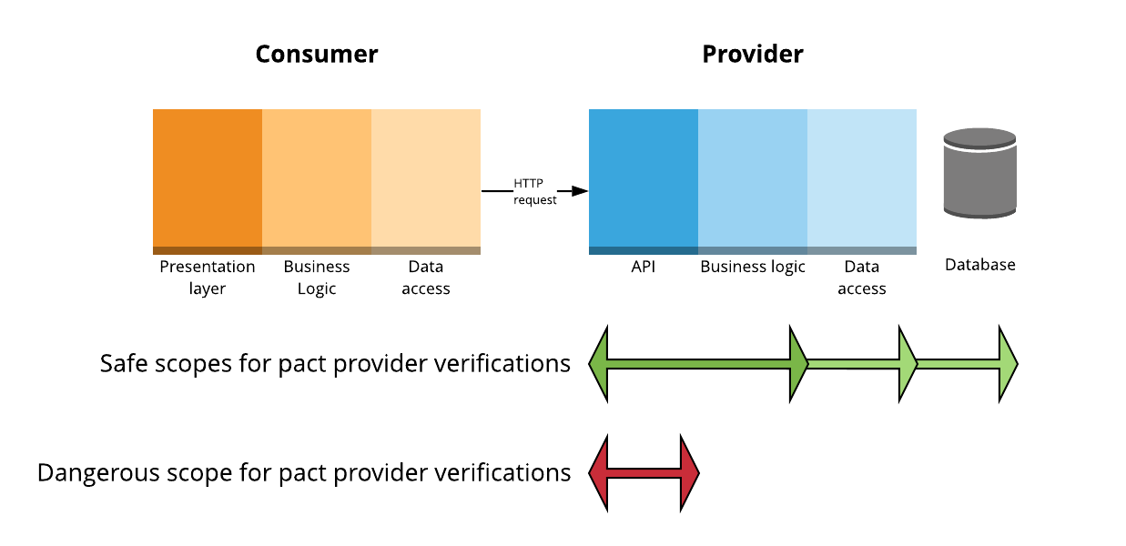
Scope of a provider verification test

Slide 33
Stubbing
Should be able to run on your local development machine
Always stub external services
Stub whichever layer(s) of your provider makes sense for you
Balance
Speed of feedback vs accuracy of feedback
Maintainability of tests
Microservice with SQLite database? Might not need to stub anything
Heavyweight proprietary database? Maybe stub DAO.
Beware of stubbing business logic though
business logic can affect the response given, and hence, make the verification results unreliable

Slide 34

Be aware!!!

Slide 35
When you stub
Be aware of the tradeoffs
Stubbing improves reliability, but reduces confidence
Make sure you have a matching “contract” test with the thing you’re stubbing to make sure you’re stubbing it right.

Slide 36
Handling authentication and authorisation
Should authentication and authorization be part of the contract?
No straight answer, it’s about the tradeoffs
Yes
Increase in certainty
Less to cover in any integrated tests
Good if the auth code is custom and likely to change
No
Simpler
If using stable standards, there may be little benefit
May be more easily covered in e2e tests

Slide 37
Options
Ignore auth (test using other types of tests)
Stub your auth services (client code or implementation)
Use provider states to create real users with matching credentials
Modify the request before sending it using live credentials (using Pact framework)
Make sure the credentials you’re replacing “match”, otherwise, there’s no point in including them in the contract
Use your own custom middleware or proxy to modify the response with live credentials
Use a 100 year token!
Notes:
Once you’re modifying it too much, you need to be sure that there is actually value including the auth in the contract at all.

Slide 38
Required
Communicate
and
collaborate
Notes:
Once you’re modifying it too much, you need to be sure that there is actually value including the auth in the contract at all.

Slide 39
Verifying Pacts - Question time

Slide 40
Pactflow/Pact Broker
Notes:
API documentation
Visualise the relationships between services
View pact diffs
Webhooks

Slide 41
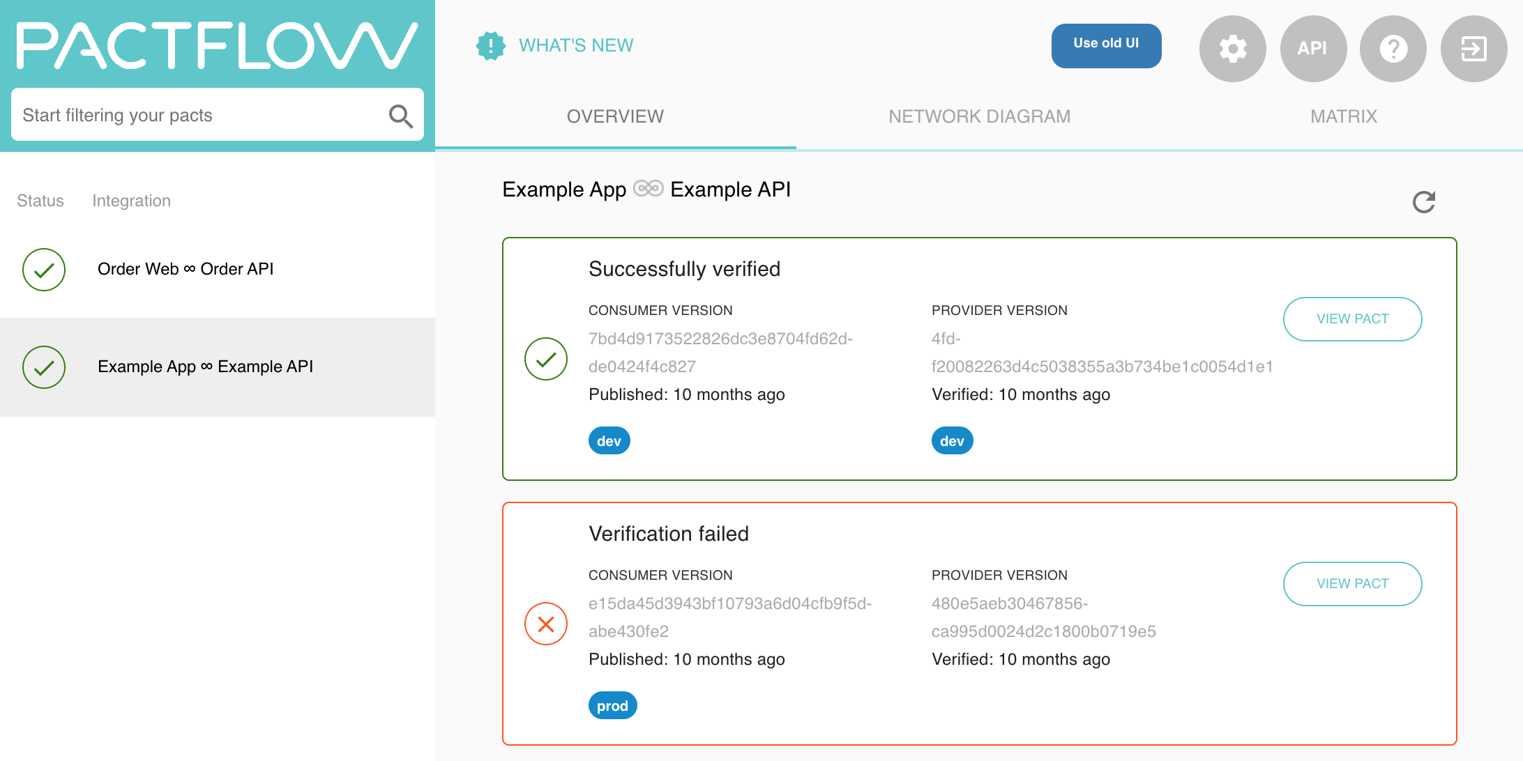

Slide 42
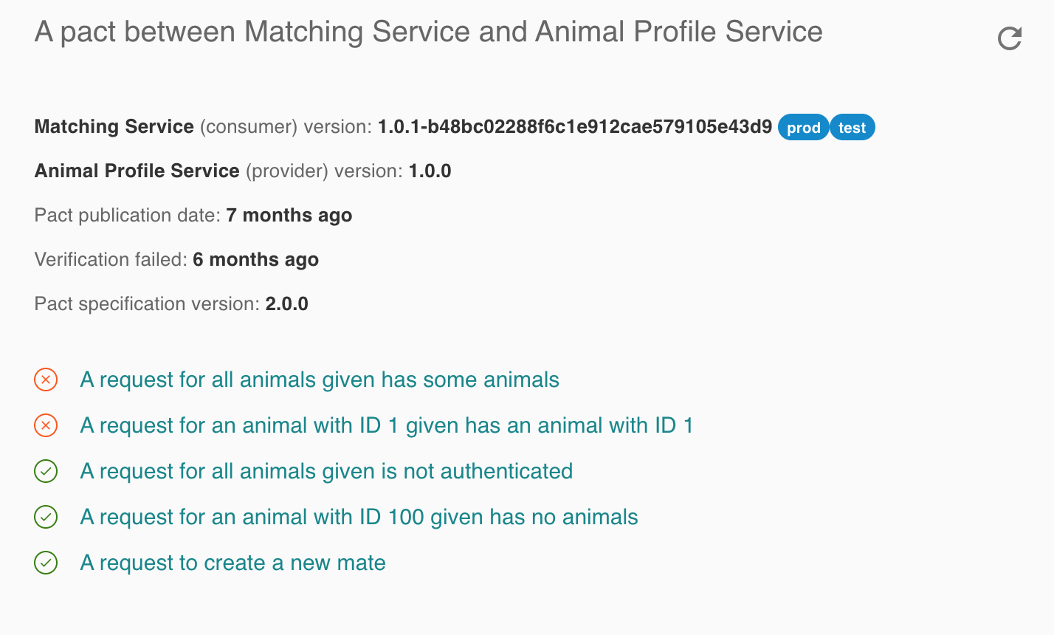

Slide 43
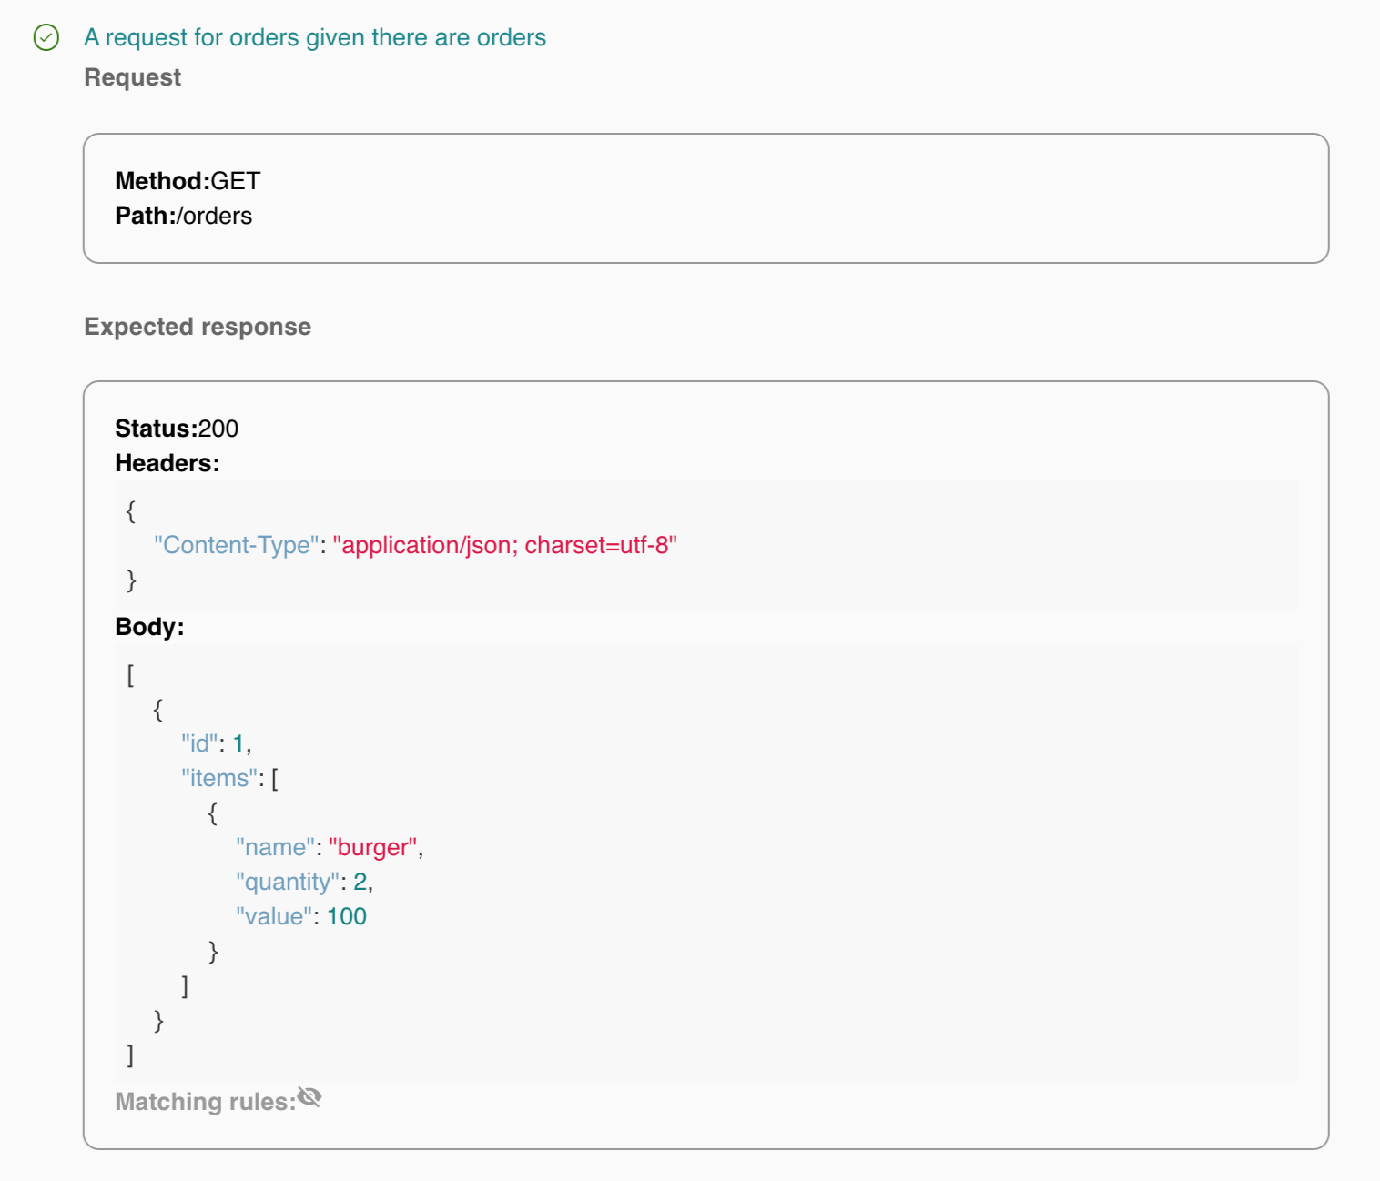

Slide 44
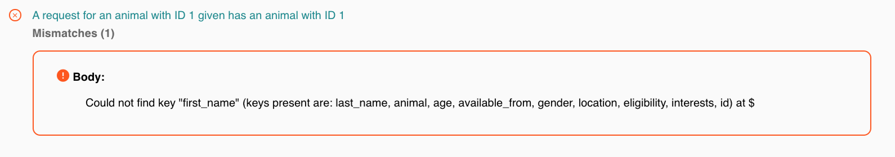

Slide 45
Using branches / deployments
Notes:
This is obviously a huge topic, so I’m going to focus on a few things in particular.

Slide 46
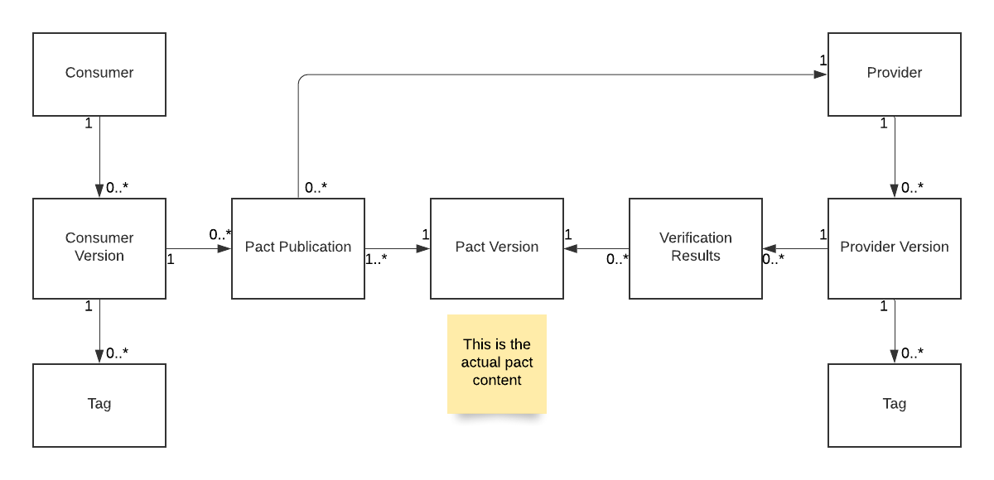
Pact Broker BDM - Pact publication
Branch

Slide 47
Pact Broker BDM - with verification results
Branch
Branch

Slide 48
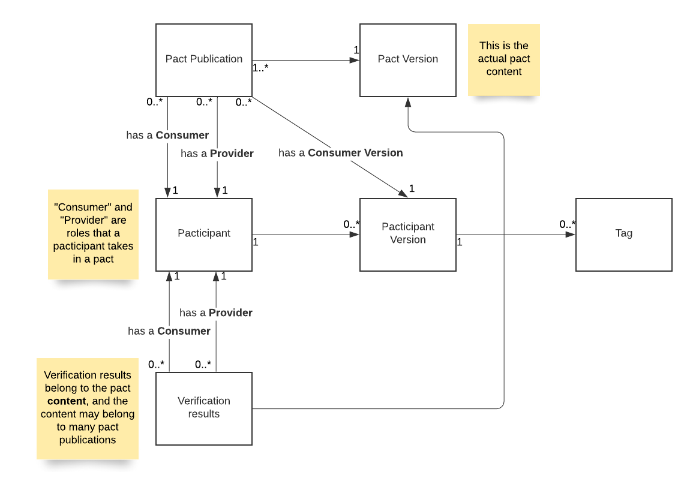
Pact Broker Class diagram
Branch

Slide 49
What are branches?
Using Tags
WHAT WE ARE KNOWN FOR
Branches in the Pact Broker are designed to model repository (git, svn etc) branches
Belong to pacticipant (application) version resources in the Pact Broker
Tell us metadata about the pacticipant version
Git branch eg. “master”, “feat/xyz”
A pacticipant version in the Pact Broker should map 1:1 to a commit in your repository. To facilitate this, the version number used to publish pacts and verification results should either be or contain the commit.

Slide 50
What are environments?
Using Tags
WHAT WE ARE KNOWN FOR
For can-i-deploy to work correctly, every team and the Pact Broker must have the same shared understanding of what an "environment" is
The Pact Broker needs to know which versions of each application are in each environment so it can return the correct pacts for verification and determine whether a particular application version is safe to deploy.
The environments should mirror your organisations environments in which you will target for deployments
You can set these up in the Pact Broker/Pactflow

Slide 51
When are branches created?
Using Tags
WHAT WE ARE KNOWN FOR
During pact publication - this tells us which branch the pacticipant version (and hence, the pact) was published from
During verification results publication - this tells us which branch the pacticipant version(and hence, the verification results) were published from

Slide 52
When are deployments recorded?
Using Tags
WHAT WE ARE KNOWN FOR
After deployment - this tells us which environment the application version is deployed to
record-deployment automatically marks the previously deployed version as undeployed, and is used for APIs and consumer applications that are deployed to known instances.
record-release does NOT change the status of any previously released version, and is used for mobile applications and libraries that are made publicly available via an application store or repository.

Slide 53
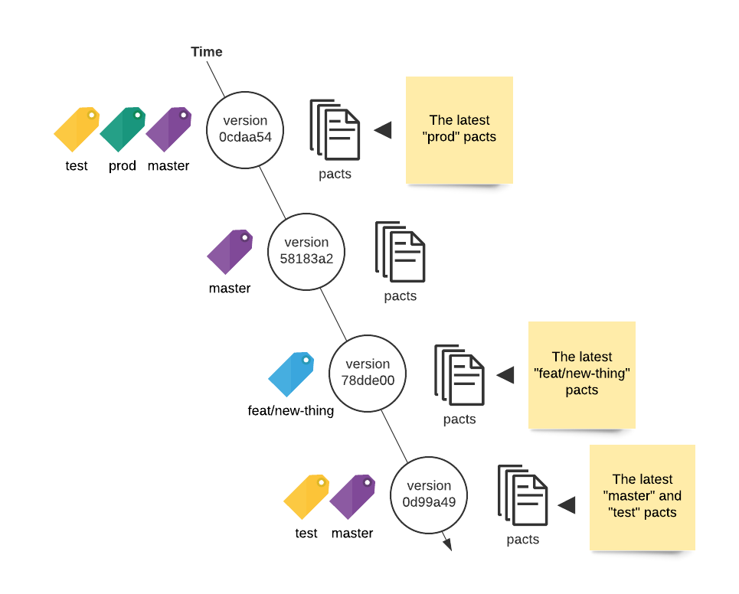
Environments and Branches over time
Using Tags
WHAT WE ARE KNOWN FOR
Deployed to test & prod envs. On main branch
Not deployed. On feature branch
Deployed to test. On main branch
Undeploys version 0cdaa54 if used with record-deployment

Slide 54
What are branches used for?
Branches are used to identify which pacts a provider should verify using consumer version selectors.
Typically, the provider should be configured to verify the pacts belonging to the main branch of each consumer (amongst others - read more here).
Branches are also used to calculate the pending status of a pact and identify work in progress pacts.

Slide 55
What does this allow us to do?
Ensure we are verifying the right pacts
Ensure backwards compatibility
Provides a mechanism for introducing changes to pacts
Easily ensure safe deployments

Slide 56
Ensure the right pacts are verified
The example used for default provider verification configurations usually specifies to verify the “overall latest pact”
What if the latest pact came from a feature branch?
Set the branch name when you publish pacts
Configure the provider version selectors to verify the main branch of the consumer
{mainBranch: true}
Set the Pacticipant main branch property to "master” (or whatever the name of your main line of development is)

Slide 57
2. Ensure backwards compatibility
Verifying “latest master” ensures our provider is compatible with the current consumer code.
Microservices -> decouple release cycles of consumer and provider
Need to ensure provider is compatible with production consumer as well as latest
Record-deployment / record-release with the stage name when you deploy application
Configure the provider to verify the latest deployed or released pacts as well as the latest main branch.
{mainBranch: true}, { deployedOrReleased: true }

Slide 58
3. Introduce changes without breaking builds
If following “consumer driven” pacts, pact is changed before provider
This would break provider build
Do changes on branch of consumer, and publish with branch name OR do changes with feature toggle and publish with toggle name
Collaborate with provider team!
Once feature pact is successfully verified, merge to main branch/turn toggle on

Slide 59
4. Easily ensure safe deployments
Each pact publication is associated with a consumer version
Each pact verification is associated with a provider version
The pact publication is linked to the verification results through the pact (content) version
There is a many to many relationship between consumer version and provider version thought pact publication/pact version/verification results

Slide 60
Quick tangent! Pre-verification
If pact with same content published multiple times with different consumer versions:
New pact publication resource each time
Reuses existing pact version
Inherits existing verification results
This is how pacts are “pre-verified”
This is why it’s best to use deterministic data

Slide 61
The Matrix
Consumer (Foo) version | Provider (Bar) version | Verification result
11 | 54 prod. | success
12 | 54 | failure
12 | 55 | success

Slide 62
The can-i-deploy CLI
Queries the matrix to determine if a set of pacticipant versions can be safely deployed together
ie. is there a pact with a successful verification result between the specified consumer and provider versions

Slide 63
can-i-deploy
Consumer (Foo) version | Provider (Bar) version | Verification result
11 | 54 prod. | success
12 | 54 | failure
12 | 55 | success
$ pact-broker can-i-deploy
--pacticipant Foo --version 11
--pacticipant Bar --version 54

Slide 64
can-i-deploy - best
Consumer (Foo) version | Provider (Bar) version | Verification result
11 | 54 prod. | success
12 | 54 | failure
12 | 55 | success
$ pact-broker can-i-deploy
--pacticipant Foo --version 11
—to-environment prod

Slide 65
Tagging with feature toggles
The current Pact Broker workflow best suits branch based development
Expects one pact per consumer version, but feature toggles mean there might be multiple variations of the pact for the same git sha.
Conceptually though, these can be thought of as different versions

Slide 66
Potential feature toggle hack
Consumer
Create pact with toggles off
Consumer version - sha eg. effe8a07
Tag with ‘base’
Create pact with toggle A on
Consumer version sha+toggle_name eg. effe8a07+feat_a
Tag with toggle name
Provider
Verify pacts with toggles off
Provider version - sha eg. d3092627
Tag with ‘base’
Verify pacts with toggle B on
Provider version - sha+toggle_name eg. d3092627+feat_b

Slide 67
CI/CD
Notes:
This is obviously a huge topic, so I’m going to focus on a few things in particular.

Slide 68
The CI/CD/Pact Broker touchpoints
Pact changed (CI)
Provider changed (CI)
Release workflow (CD)

Slide 69
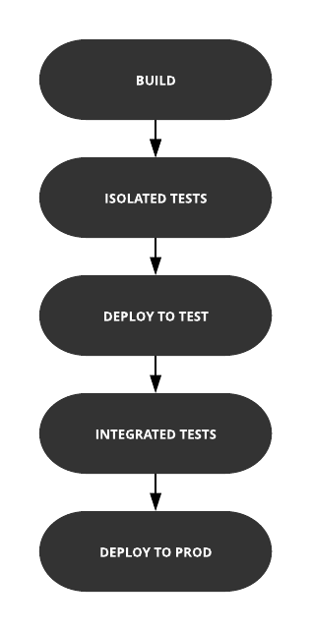
Build pipeline without Pact

Slide 70
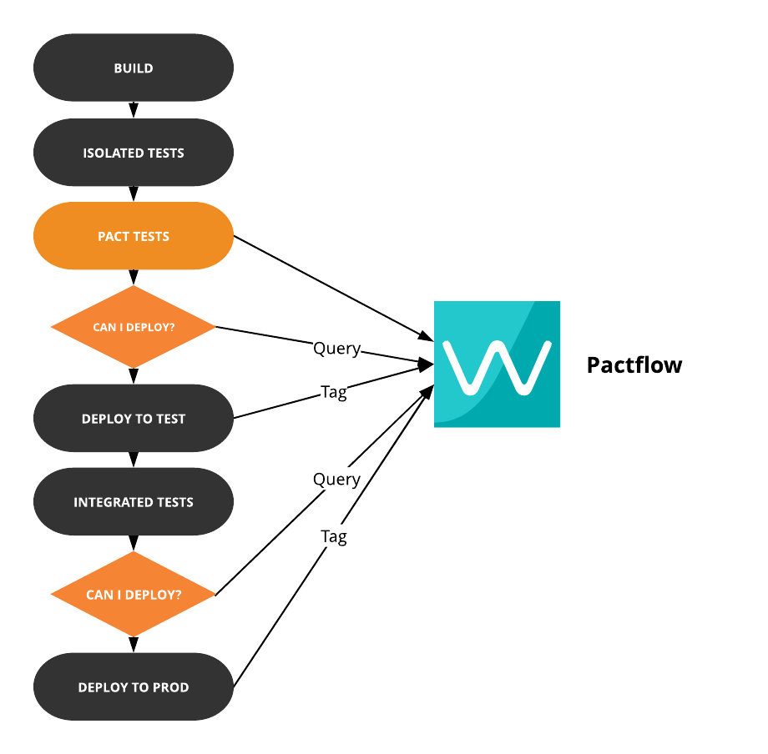
Build pipeline with Pact
Record deployment
Record deployment

Slide 71
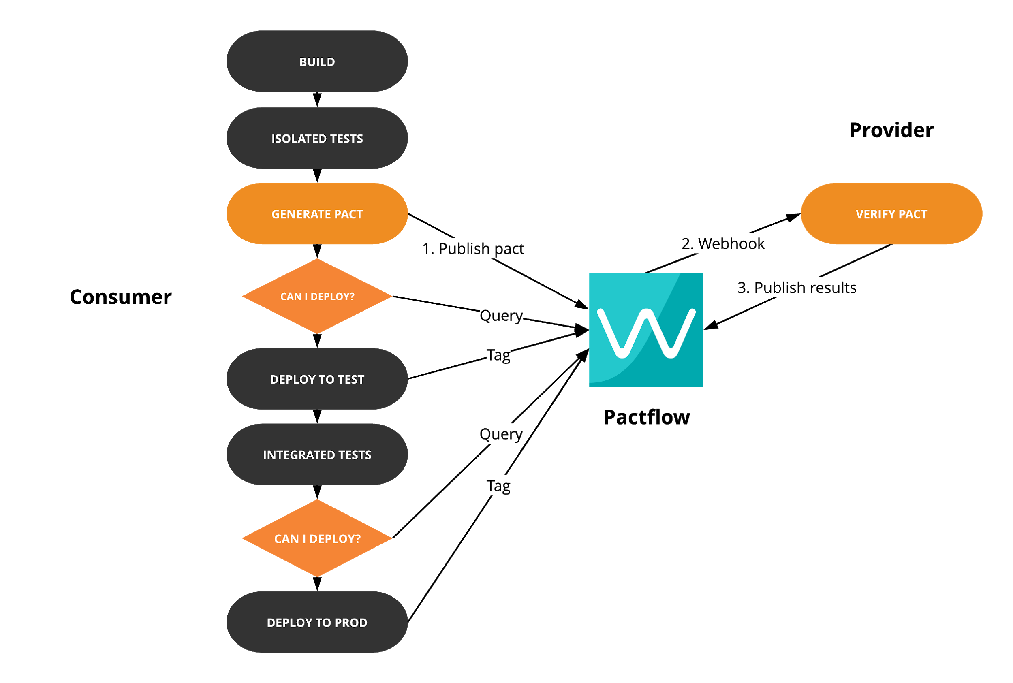
Build pipeline with Pact - Consumer
Record deployment
Record deployment
Notes:
You might be thinking, will can-i-deploy break my master build?
Not if you’ve followed the recommendation of doing changes on a feature tag
By the time the consumer code gets to main line of development, it should already be pre-verified by the provider’s main line of development

Slide 72
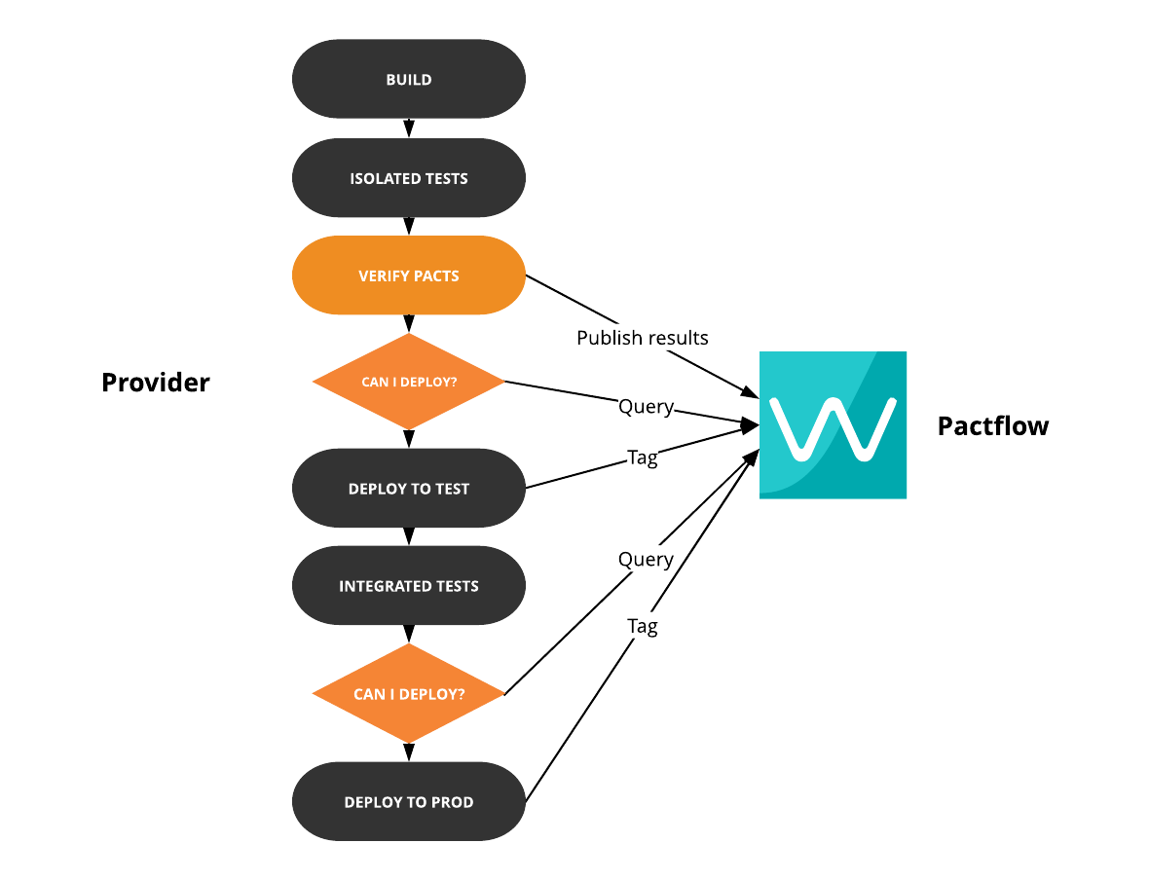
Build pipeline with Pact - Provider
Record deployment
Record deployment

Slide 73
For extra brownie points
Git statuses
Slack updates

Slide 74
CI/CD - Question Time

Slide 75
Pending pacts - the problem
Changes to the pact can break the provider’s build

Slide 76
Pending pacts - the solution
If the pact content has not yet been successfully verified:
It is considered “pending”
If verification fails, it will not fail the build
Once it has been successfully verified:
It is no longer “pending”
Any failure can only be due to a change in the provider
If verification fails, it will fail the build

Slide 77
Pending pacts - something to note
The pending status is calculated based on the branch that will be applied to the provider version when the results are published

Slide 78
WIP Pacts - the problem
Changed pact published with branch ‘feat/foo’
‘contract_requiring_verification_published’ webhook triggers verification - failure
Provider implements required changes
Provider runs verification for main consumer branch ‘master’ and all deployed and released versions
Unless provider team changes the consumer selectors to add the feature branch to verify in the configuration, the ‘feat/foo’ pact won’t get a successful verification result.

Slide 79
WIP Pacts - the solution
Changed pact published with branch ‘feat/foo’
‘contract_requiring_verification_published’ webhook triggers verification - failure
Provider implements required changes
Provider runs verification for main consumer branch ‘master’ and all deployed and released versions - it also automatically verifies any “work in progress” pacts.
A “work in progress” pact is one which is the latest for its branch, and has not yet been successfully verified.

Slide 80
Organisational Scale
Notes:
This is obviously a huge topic, so I’m going to focus on a few things in particular.

Slide 81
3 key steps to ensure and scale enterprise wide adoption
Stakeholder buy-in: Using Pact requires collaboration and commitment from each consumer and provider team. Getting buy-in from key stakeholders and aligning on clear goals, objectives and how we will measure success.
Run a PoC: In our experience, it’s best to start small with an initial MVP and a reduced working group on which to establish the appropriate working context, validate concepts and hypotheses. With these learnings it will be easier to scale and expand across the organisation.
GoP: Once a PoC has demonstrated value in moving forward, the challenge becomes scaling contract testing throughout the organisation. There is value in creating an internal group of practice to accelerate adoption, training, eduction and scaling.

Slide 82
Group of Practice (GoP)
Metrics: Establish metrics and KPI’s to track the speed of adoption across the organisation
Processes: Develop a standard methodology for team adoption with step-by-step instructions including
Workflow of all contract testing related tasks within every spring
Recommended development model that follows the release cycle using a branching model
Adaptation of the SDLC to include contract testing
Definition of the onboarding and monitoring processes for all relevant teams.
Communication: Facilitate real-time collaboration by enabling the rapid collection of data and ideas
Organise regular “open sessions” to address/resolve any questions or issues
Regular meetings to track progress with stakeholders (including Dev, QA, SRE, PO)
Create an open commenting/annotation system to loop in others and improve coverage
Tracking: Reporting of KPI progress to all key stakeholders
Support and follow up for all teams
Feedback to revise and refine all processes and practice

Slide 83
How to onboard teams?
Buy in: Establish the current problems and how the new model will help solve those challenges
Training: Step by step training and workshop, based on company domain
Alignment: Define the main objects and agree on metrics to measure adoption
Commitment: Reserve time to commit to adoption of new practice
Adoption: Set a group of Contract testing champions to help build spikes
Champions pair programming
Continuous support via champions and GoP
Progress tracking: Follow up and KPI’s monitoring
Refinement: Open talks and retros with teams to gather feedback

Slide 84
Quantitative Metrics
Engagement
No of pipelines with can-i-deploy tool enabled
No of teams/projects with contracts in Pactflow
No of endpoints covered by contracts (contract testing coverage)
Impact
Time spent on manual testing (we want to see a reduction)
Deployment frequency - how often do you release?
Lead time for change - how long does it take to get a release from commit to production
Change failure rates - how frequently does a change result in a failure as a percentage
Mean time to recovery (MTTR) - how long does it take to recover from a failure

Slide 85
Qualitative Metrics
How is the team feeling with the new tools?
What are the plans and gains?
How active is the tool?
How active and supportive is the community?

Slide 86
Example results from a customer after 7 sprints
Governance
2 teams training in CT techniques, 4 CT champions
8 KPI’s defined
GoP setup to engage teams and continue CT using Pact gaining adoption
Implementation of RBAC in Pactflow
Technical Aspects
6 endpoints covered with CT
2 Jenkins pipelines integrated with Pactflow
2 bugs detected which were present in production environments
Times
8 hours to develop first CT test
3 weeks to integrate first pipeline
4 weeks from the project start date to discover first bug

Slide 87
Learnings: Contract testing champions as a key role
Main role to accelerate the process
Evangelises the rest of the teams
Supports the practice also over the organisation
Ownership of the practice
Autonomy and trust of the organisation to make decisions

Slide 88
Learnings: A Group of Practice is a must to expand adoption
Group of Practice should always be established to guide, support & continuously track the degree of adoption of the new practice within an organisation. Key responsibilities include
Evangelise about the use and benefits of contract testing
Train teams in the technique
Establish metrics for monitoring and checking the degree of success
Collect feedback from the teams
Resolve dependencies and impediments
Provider teams with adequate resources to implement contract testing efficiently
Prepare status reports
Organise meetings, seminars, workshops, lectures on contract testing within the organisation

Slide 89
Learnings: Monitoring metrics are key to track success
For any process of implementation of new practices in an organisation, it is important to establish monitoring metrics that allow us to know the degree of evolution of the same. This data will give us information on:
Degree of implementation in teams
Effectiveness of contract testing within the organisation
Alignment with business objectives
Fulfilment of expectations
Detection of deviations or inefficiencies

Slide 90
Thank you - Question Time

